Slide 1
Video Stitching Detection
Srisa Changolkar, Celestina Saven, Vinay Senthil, Kevin Sun
https://github.com/ksun0/cis-581-final-project-video-stiching-detection

Slide 2

Videos, panoramas, and drone footage are all over the internet.

Slide 3
In this project, we focus our attentions to stitching and detecting objects in an important staple of WFH life: desk setups.

Slide 4
Step 1: Video Stitching

Slide 5
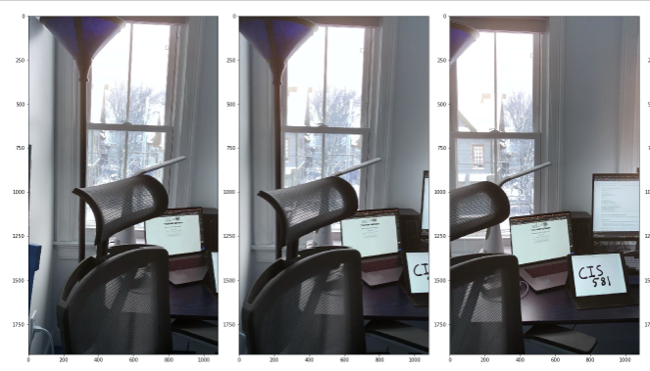
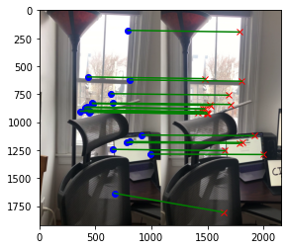
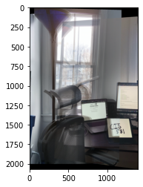
CIS581 Project 4 Results: SIFT, RANSAC, Simple Combining

Slide 6
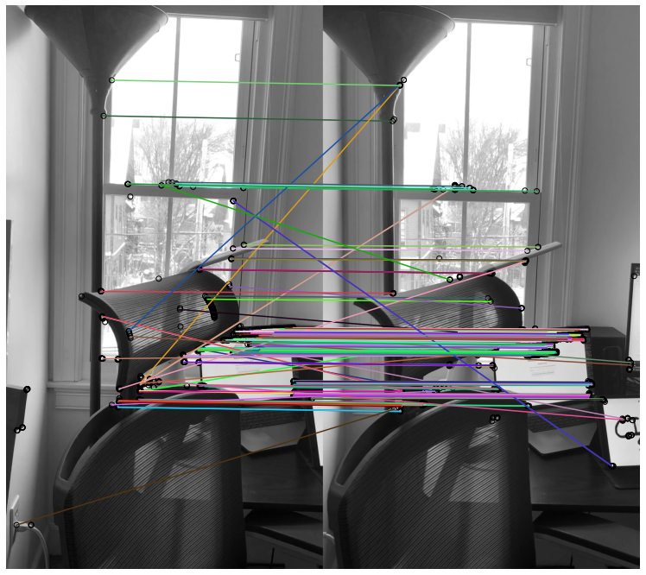
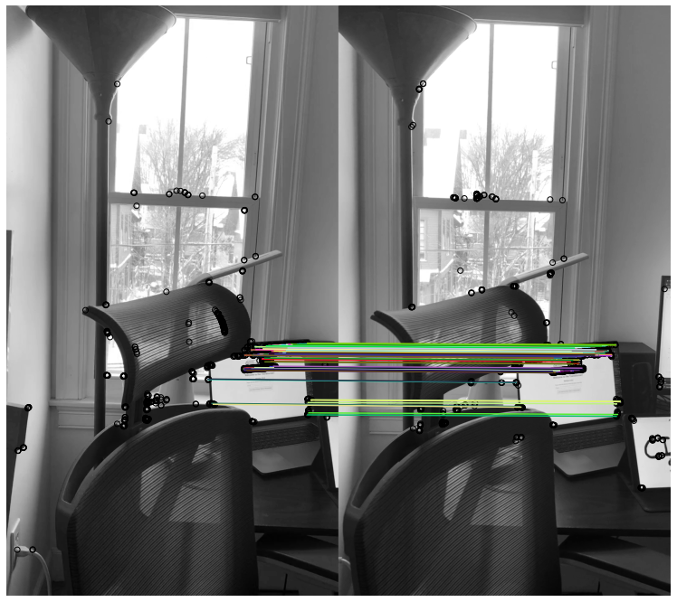
2. ORB and RANSAC

Slide 7
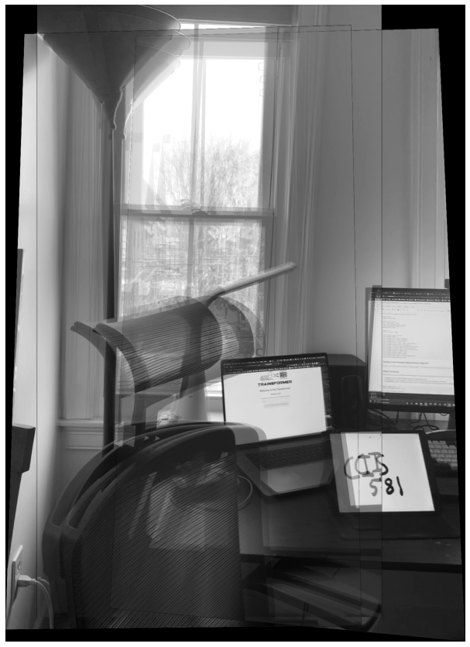
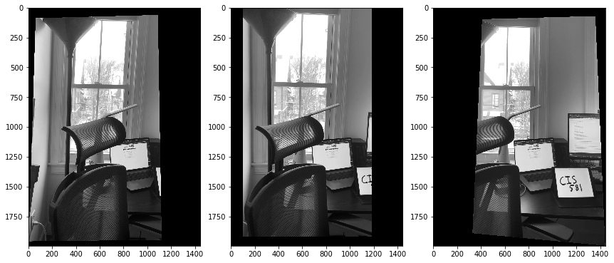
3. Warping (with inverse mapping)

Slide 8
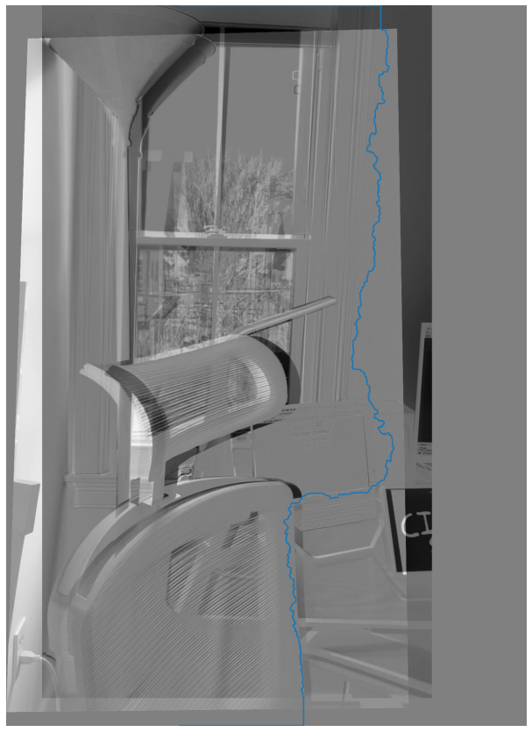
4. Combining Images:
Minimum Cost Path

Slide 9
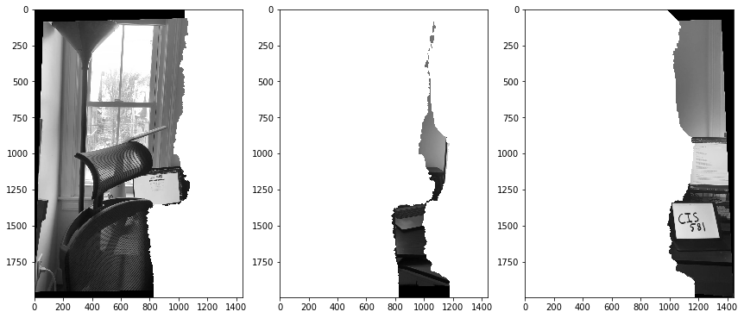
5. Masks to blend the individual images together

Slide 10
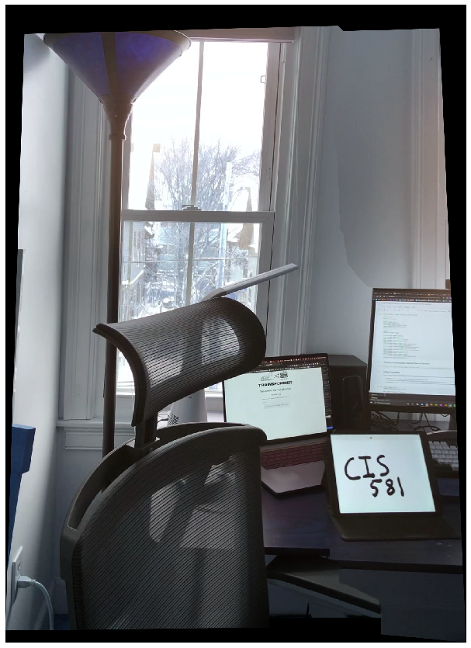
6. Final Stitched Result

Slide 11
7. Optical Flow

Slide 12
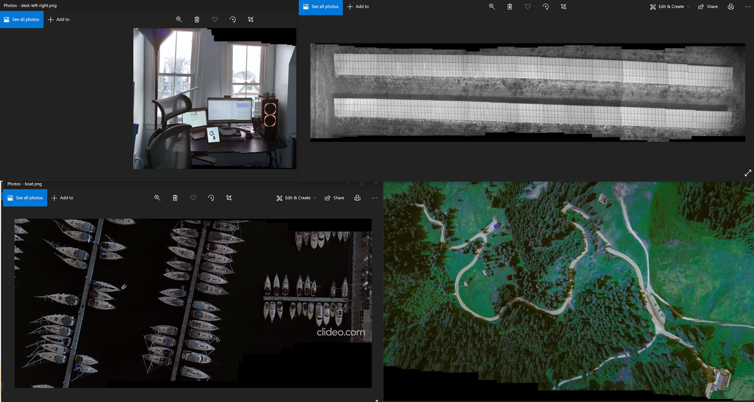

Slide 13
Step 2: Object Detection

Slide 14
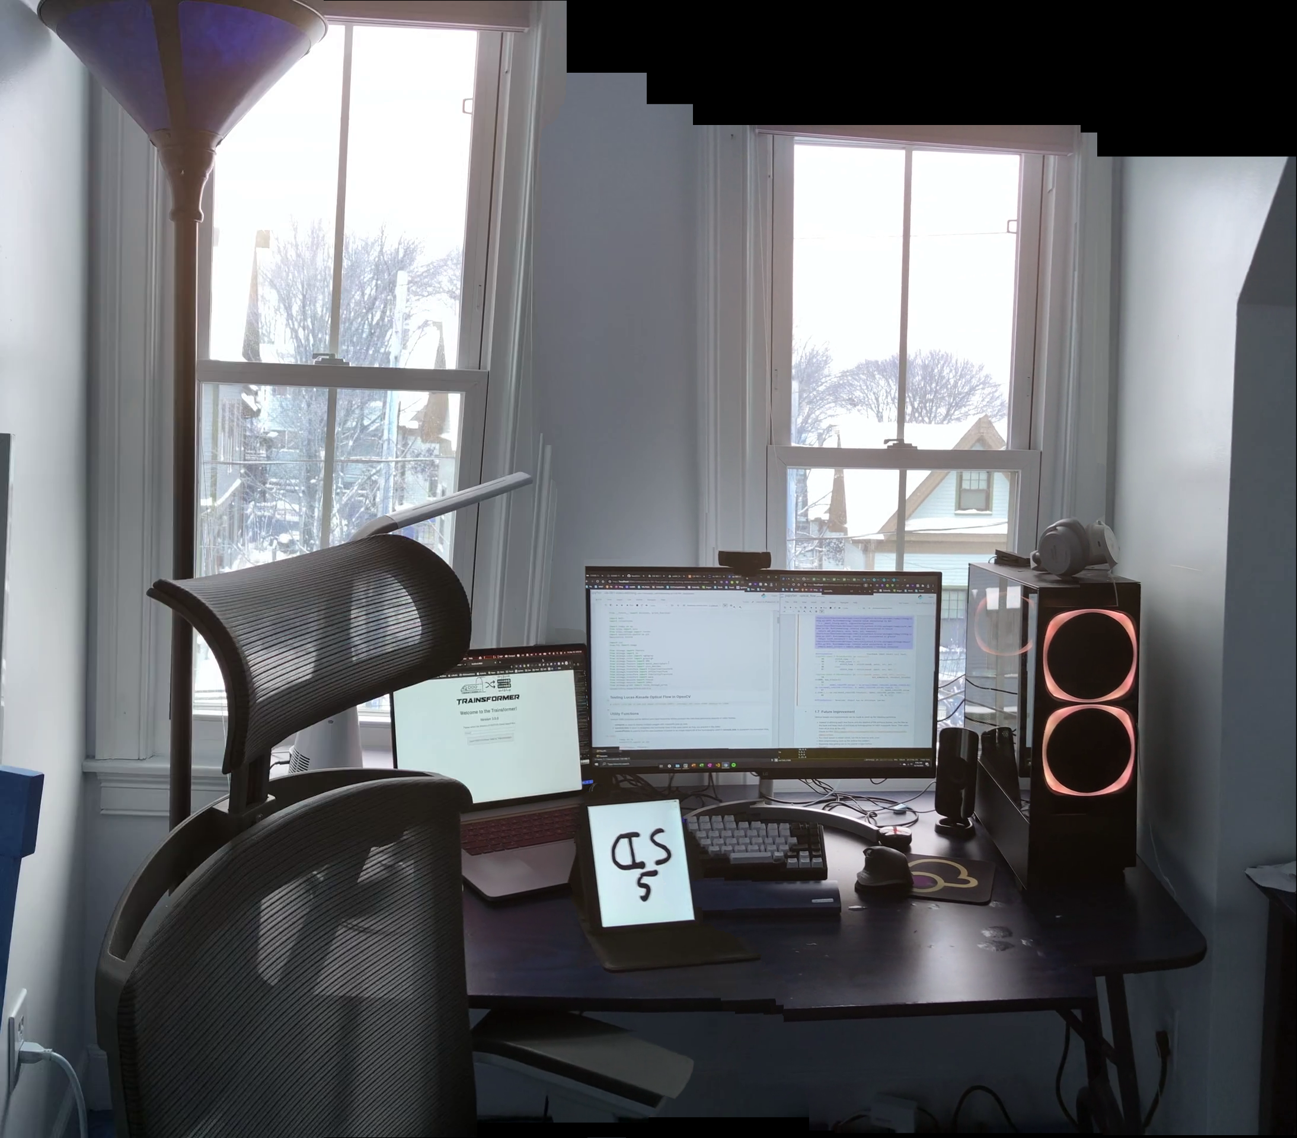
Outline of Object Detection
Goal: Identify desktop items from this stitched image
Initialize the pretrained model
Reshape the final layer(s) to have the same number of outputs as the number of classes in the new dataset
Define for the optimization algorithm which parameters we want to update during training
Run the training loop again

Slide 15
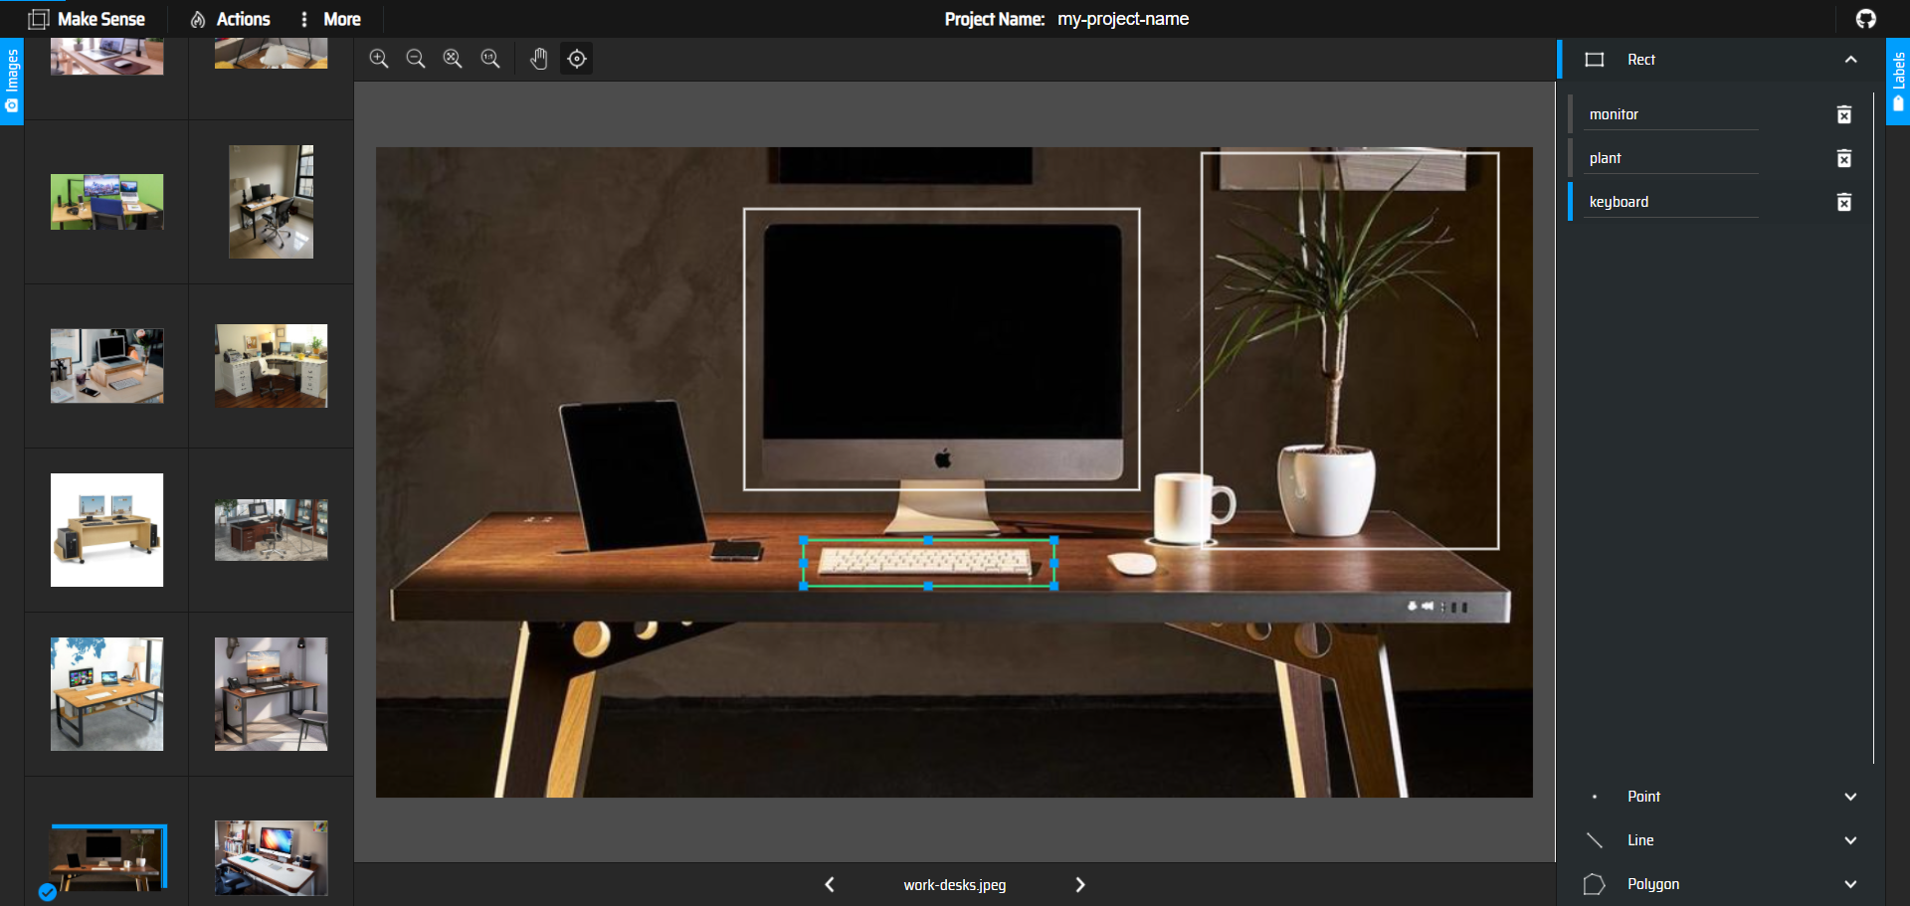
Creating Training Labels: Makesense.ai

Slide 16
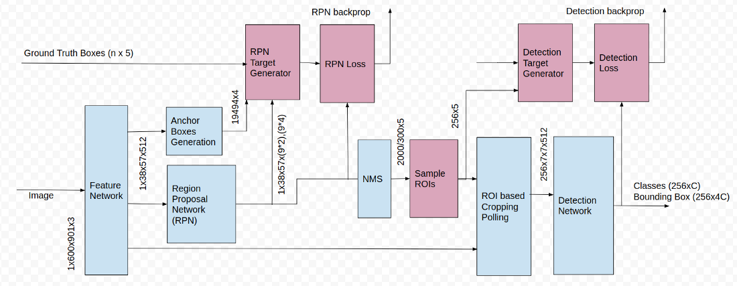
Neural Net Structure
Used a pre-trained Faster-RCNN to identify objects
Created a training set of 60 images
Annotated each image with 4 labels: monitor, keyboard, desktop, plant
For loss: cross entropy loss for classification loss and taking differences in euclidean distances between actual and predicted results for localization loss

Slide 17
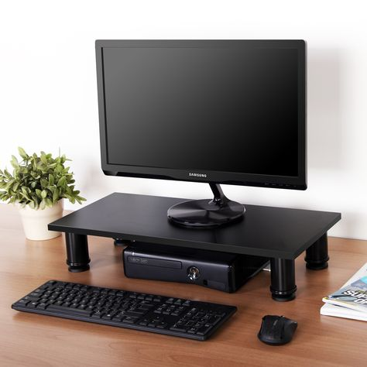
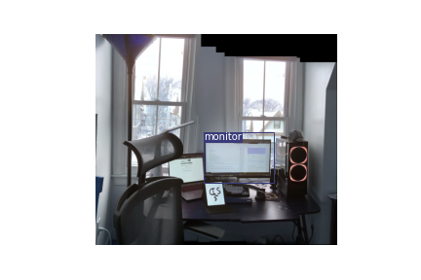
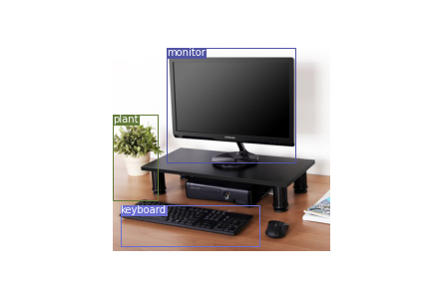
Results after Object Detection
Results of the stitched image:
Results of object detection on one of the training images we used

Slide 18
Future considerations
Image Stitching:
For something gridlike, apply homography to edge/line detection and do line straightening i.e. (Sobel y-direction filter, canny edge detection, calculate Hough lines)
Use the first frame as a base and keep track of and build up homographies for each successive frame. Then stitch them all at once at the end.
Too much space in model robust, but this can be fixed by auto cropping.
More preprocessing such as the vertical line rotation.
Object Detection:
Utilize a larger training sample set with greater variety (i.e. ’non-desk’ images): 50 images was not enough for accurate detection. Maybe train on the COCO dataset.
Train a R-CNN from scratch (something we did not have time to repeatedly do within the span of this project) and compare results to those obtained via transfer learning.
Grayscale images before training or prediction

Slide 19
Final Live Demo

